Slide 1
SMART MIRROR

Slide 2
INDEX
COMPANY PORTFOLIO
INDEX
1. INTRODUCTION
2. DESIGN LAYOUT
3. SOFTWARE SETUP
4. HARDWARE SETUP

Slide 3
INTRODUCTION
COMPANY PORTFOLIO
What is Smart Mirror
Smart mirrors are straight from science fiction. They’re part of an optimistic vision of the future that imagines a world where screens and data are everywhere, ready to feed you whatever information you need at a moment’s notice. Basically, the mirror is looks like normal mirror but when someone stand in front of it the scene changes. The mirror provides a functional, user friendly and interactive UI to its user for accessing their health information, live location etc. It has widgets for displaying the current whether conditions, Time .The Smart Mirror would help in developing smart houses with embedded artificial intelligence, as well as finding its applications in industries.
The raspberry pi is programmed using python and connects to a monitor with inbuilt speaker so as to provide an onscreen interface and voice assistance as well. Section 2 focuses on Design of mirror. The working while making Smart Mirror is covered under Section 3. Section 4 comments on the Functional Overview of mirror. Section 5 covers problems and issues that may occur while development.

Slide 4
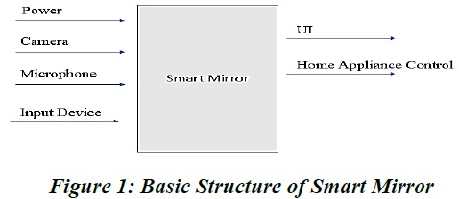
DESIGN LAYOUT
COMPANY PORTFOLIO
Design
Power connection, microphone for voice input, camera for image processing forms the basic input devices for the mirror. The monitor and speakers forms the output Design devices of the mirror.
Smart Mirror doesn’t fully show the all the equipment that are to be connected to raspberry pi, but covers all major functional units. The microphone is connected via sound card on USB port of Pi. The camera can be connected to USB port or the Pi camera can be connected to camera slot on Pi. To access the internet the Pi is connected to home Wi-Fi network or with the LAN cable. The programming of the Pi for displaying the UI on the screen is done using Python.

Slide 5
DESIGN LAYOUT
COMPANY PORTFOLIO
WORKING
The working of each components in smart mirror is explained in this section.
1. Two-Way glass mirror
The two-way mirror is what gives the mirror its real identity. It’s really magic mirror as it has reflective surface at one side and also its transparent for light with good intensity. The mirror stays at the front where the user can watch himself/herself in the mirror at the same time the allows the light from monitor to pass through it and make available the UI.
2. Monitor
The monitor is directly connected to Raspberry Pi via HDMI interface thus providing display as well as voice output.
3. Raspberry Pi
The raspberry pi is the most vital part of the mirror, it forms the processing unit of the mirror. The Pi is like motherboard having all the required constituents which forms a great CPU. Its size of a credit card and still it can perform like a full-fledged computer. The programming of Pi is done using Python language. Installation of OS on Raspberry Pi is quite a simple process. First you have to download Raspbian OS which is great OS of Raspberry Pi for beginners. The Raspbian is just a flavor of Debian OS .

Slide 6
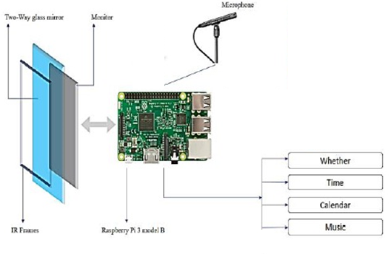
DESIGN LAYOUT
COMPANY PORTFOLIO
4. Microphone
The microphone is used to give voice input to the mirror. Along with touch capability a voice input makes the system very reliable and robust in working. A sensitive microphone takes voice command from the user and processes it to do corresponding action.

Slide 7
LIST OF COMPONENTS
COMPANY PORTFOLIO
Raspberry pi
MicroSD card (min 8GB)
Display
Sound card
Microphone
Two way glass mirror
Internet access

Slide 8
SOFTWARE SETUP
COMPANY PORTFOLIO
2. Software Setup
Step 1: Install Raspbian OS
Step 2: Connect to internet
Step 3: Update OS and Install Python and other packages
Step 4: Connect Microphone to Raspberry Pi
Step 5: Create Google Maps API
Step 6: Download and Run Script

Slide 9
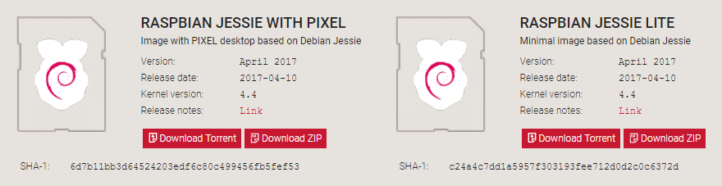
SOFTWARE SETUP
COMPANY PORTFOLIO
Step 1. How to install Raspbian on the Raspberry Pi
Installing Raspbian on the Raspberry Pi is pretty straightforward. We’ll be downloading Raspbian and writing the disc image to a microSD card, then booting the Raspberry Pi to that microSD card. For this project, you’ll need a microSD card (go with at least 8 GB), a computer with a slot for it, and, of course, a Raspberry Pi and basic peripherals (a mouse, keyboard, screen, and power source). This isn’t the only method for installing Raspbian (more on that in a moment), but it’s a useful technique to learn because it can also be used to install so many other operating systems on the Raspberry Pi. Once you know how to write a disc image to a microSD card, you open up a lot of options for fun Raspberry Pi projects.
Step 1.1: Download Raspbian

Slide 10
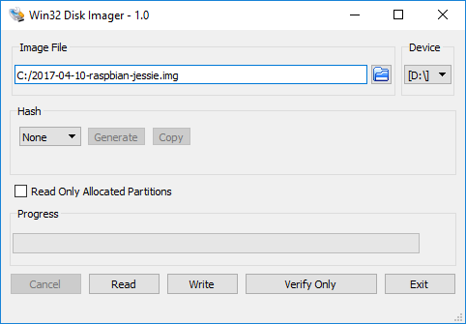
SOFTWARE SETUP
COMPANY PORTFOLIO
First things first: hop onto your computer (Mac and PC are both fine) and download the Raspbian disc image. Give yourself some time for this, especially if you plan to use the traditional download option rather than the torrent. It can easily take a half hour or more to download.
Step 1.2: Unzip the file
The Raspbian disc image is compressed, so you’ll need to unzip it. The file uses the ZIP64 format, so depending on how current your built-in utilities are, you need to use certain programs to unzip it. If you have any trouble, try these programs recommended by the Raspberry Pi Foundation:
Windows users, you’ll want 7-Zip or WinRAR.
Mac users, The Unarchiver is your best bet.
Linux users will use the appropriately named Unzip.
Step 3: Write the disc image to your microSD card

Slide 11
SOFTWARE SETUP
COMPANY PORTFOLIO
Next, pop your microSD card into your computer and write the disc image to it. You’ll need a specific program to do this:
Windows users, your answer is Win32 Disk Imager.
Mac users, you can use the disk utility that’s already on your machine.
Linux people, Etcher – which also works on Mac and Windows – is what the Raspberry Pi Foundation recommends.
The process of actually writing the image will be slightly different across these programs, but it’s pretty self-explanatory no matter what you’re using. Each of these programs will have you select the destination (make sure you’ve picked your microSD card!) and the disc image (the unzipped Raspbian file). Choose, double-check, and then hit the button to write.
Step 1.4: Put the microSD card in your Pi and boot up
Once the disc image has been written to the microSD card, you’re ready to go! Put that sucker into your Raspberry Pi, plug in the peripherals and power source, and enjoy. The current edition to Raspbian will boot directly to the desktop. Your default credentials are username pi and password raspberry.

Slide 12
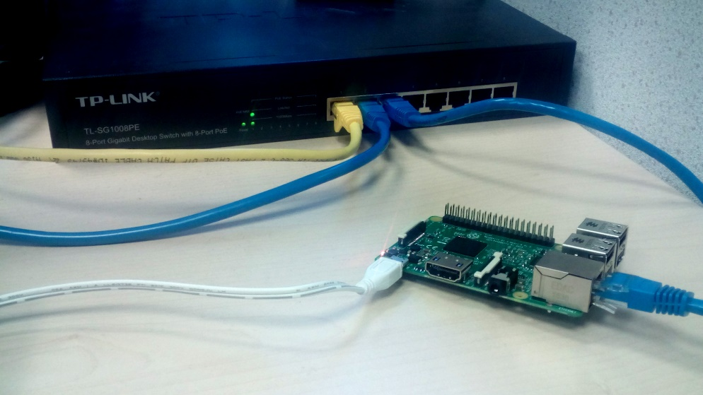
SOFTWARE SETUP
COMPANY PORTFOLIO
Step 2: Connect to internet
Wired Ethernet connection
Consumer routers are usually configured to issue an IP address to your devices via DHCP as soon as they are connected. This means that in most cases, connecting your Pi to the internet via a wired Ethernet connection is as simple as connecting your Raspberry Pi to your internet router/switch with a standard Ethernet cable.

Slide 13
SOFTWARE SETUP
COMPANY PORTFOLIO
Troubleshooting an Ethernet connection
Should you run into an issue on a wired Ethernet connection you should test the connection on your PC/laptop first. If your PC can get an internet connection on a wired Ethernet cable, typically the Pi can too.
Possible issues may include:
A damaged Ethernet cable. This is pretty rare but it can happen.
DHCP may be turned off on your router and because of that your device is not being issued an IP address. Most consumer routers have DHCP enabled by default, so if it is disabled it's quite likely that you have a special networking setup that you are aware of which may require a static address be assigned to your Pi.
If you're connecting through a USB-to-Ethernet adapter instead of default Ethernet port you might run into driver issues if your USB device is not natively supported in your chosen operating system. You may wish to try using the standard Pi Ethernet port first to establish if the issue is general, or is specific to the particular USB device you are using.
A router or general internet fault. If you can't get any internet access via your router (including to your PC/laptop), you may need to replace the router and/or raise the issue with your ISP. They will probably ask the typical question 'have you power cycled it?', so it's worth giving that a shot too.

Slide 14
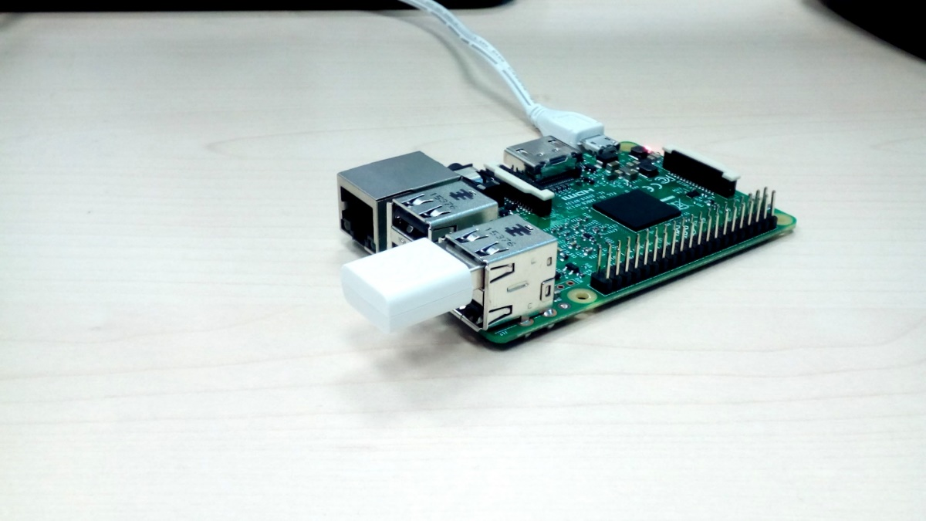
SOFTWARE SETUP
COMPANY PORTFOLIO
Wireless connection
At the time of writing, only Raspberry Pi 3 devices have built in Wifi. For older devices, The WiPy USB Wireless module is available from the Raspberry Pi Store.
Check your network is visible and in range
Open a terminal emulator and type in the command below to get a list of networks visible to your Pi:
sudo iw dev wlan0 scan | grep SSID
Configure WiFi
In our case, we set up a network named DATAPLICIT and we will now configure our Pi to connect to it after boot up.
Open up network interfaces file using text editor such as nano.

Slide 15
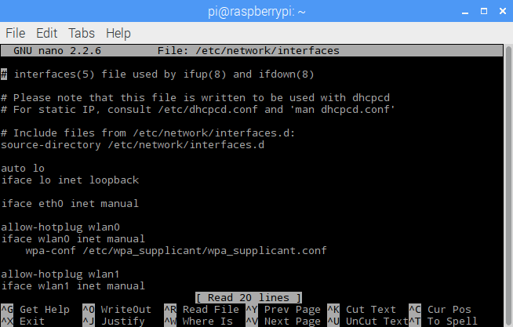
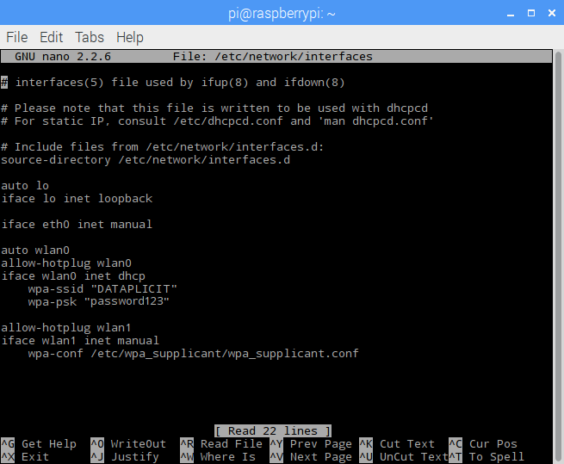
SOFTWARE SETUP
COMPANY PORTFOLIO
Edit network interfaces configuration file
sudo nano /etc/network/interfaces
When you open this file it should look similar to the one shown below.
wlan0 abModifyove to match that which is shown below. You will need to supply your own network name and password instead of DATAPLICIT and password123
Exit the text editor by pressing CTRL + X then y and then ENTER.
All done!
Last thing to do is to reboot the system.
sudo reboot

Slide 16
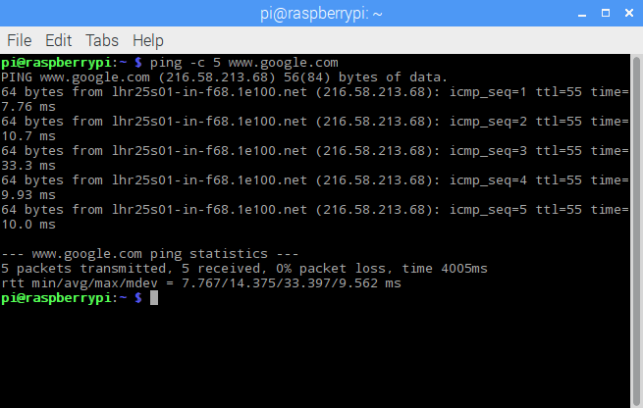
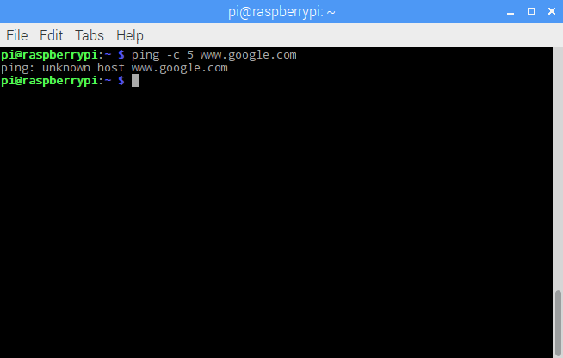
SOFTWARE SETUP
COMPANY PORTFOLIO
Test your connection
You can try to 'ping google.com' to check that your internet connection is working. If this fails, either google.com is broken or your internet connection isn't working, needless to say the latter is more likely. :)
The command below will send 5 packet to google and return connection statistics.
sudo ping –c 5 www.google.com
On successful ping you will see a result similar to the one below.
If your connection isn't working, you will see something similar to the below (or some other error).

Slide 17
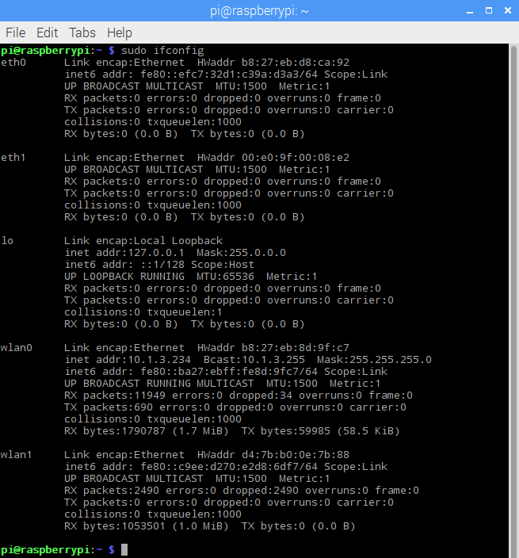
SOFTWARE SETUP
COMPANY PORTFOLIO
Find your IP address
To find the IP of the interfaces on your Raspberry Pi use the command below.
Find IP address of your Pi
sudo ifconfig
You should see a result similar to the one below. To find your IP you have to look at the interface you're currently using e.g. Wlan0 and then look at the inet (IPv4) section.

Slide 18
SOFTWARE SETUP
COMPANY PORTFOLIO
Step 3: Update OS and install python along with the required packages
The first and probably the most important reason is security. A device running Raspbian contains millions lines of code that you rely on. Over time, these millions lines of code will expose well-known vulnerabilities known as Common Vulnerabilities and Exposures (CVE), which are documented in publicly available databases meaning that they are easy to exploit. Here is a example of a recent CVE found in KODI that provides a bit more insight on what information is available in the database and how CVEs are tracked. The only way to mitigate these exploits as a user of Raspbian is to keep your software up to date, as the upstream repositories track CVEs closely and try to mitigate them quickly.
The second reason, which is related to the first, is that the software you are running on your device most certainly contains bugs. Some bugs are CVEs, but bugs could also be affecting the desired functionality without being related to security. By keeping your software up to date, you are lowering the chances of hitting these bugs.
APT (Advanced Packaging Tool)
To update software in Raspbian, you can use the apt tool in a terminal. Open a terminal window from the taskbar or application menu:

Slide 19
SOFTWARE SETUP
COMPANY PORTFOLIO
First, update your system's package list by entering the following command:
sudo apt-get update -y
Next, upgrade all your installed packages to their latest versions with the following command:
sudo apt-get upgrade -y
sudo apt-get dist-upgrade -y
Updating the kernel and firmware
The kernel and firmware are installed as a Debian package, and so will also get updates when using the procedure above. These packages are updated infrequently and after extensive testing.
Running out of space
When running sudo apt-get dist-upgrade, it will show how much data will be downloaded and how much space it will take up on the SD card. It's worth checking with df -h that you have enough free disk space, as unfortunately apt will not do this for you. Also be aware that downloaded package files (.deb files) are kept in /var/cache/apt/archives. You can remove these in order to free up space with sudo apt-get clean.
Install python3
sudo apt-get install python3
Install Tkinter: For GUI based application
sudo apt-get install python3-tk

Slide 20
SOFTWARE SETUP
COMPANY PORTFOLIO
Step 4: Connect Microphone and test
If you want to be sure that your microphone works well, the easiest way is to do a recording test To do this, launch a terminal and type the following command:
arecord -D plughw:1,0 test.wav
Then open the sound file with your favorite audio player to check that the microphone recorded well your voice
For example:
omxplayer test.wav

Slide 21
SOFTWARE SETUP
COMPANY PORTFOLIO
Step 5: Create Google Maps API
https://developers.google.com/maps/documentation/maps-static/intro

Slide 22
SOFTWARE SETUP
COMPANY PORTFOLIO
Step 6: Download the python script and configure it
Change the Maps API
Change the weather and clock API
Enter the health positive credentials

Slide 23
ADDITIONAL RESOURCES
COMPANY PORTFOLIO
Mentornet Resources
Link
Contact us
Articles to read
CERTIFICATE
COMPANY PORTFOLIO

